Slide 1
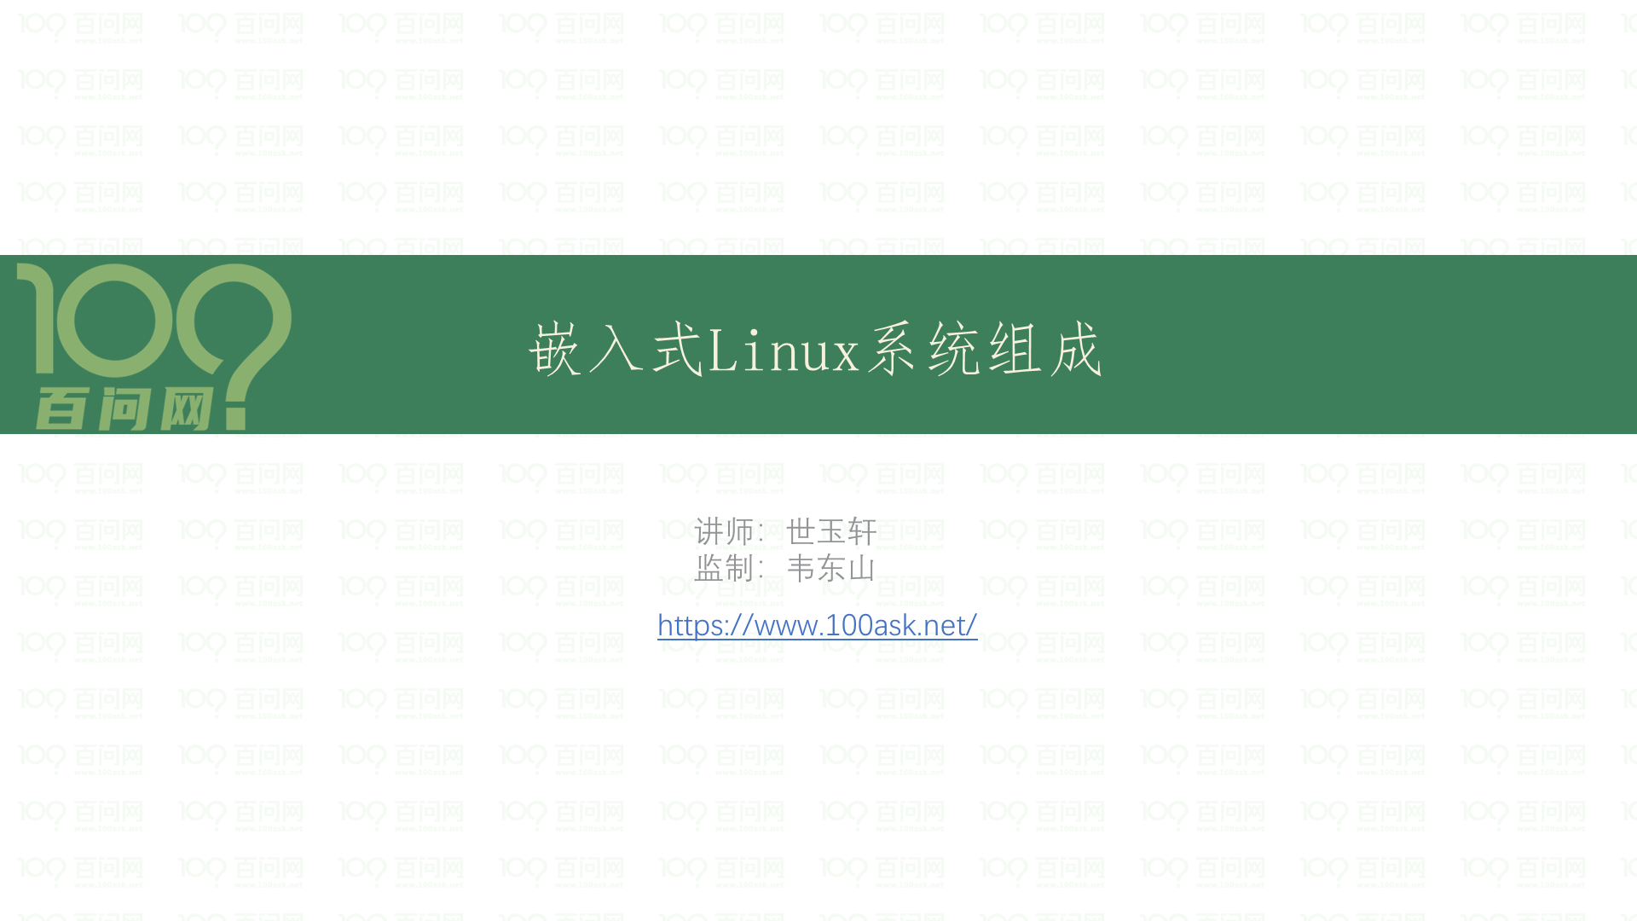

Slide 2
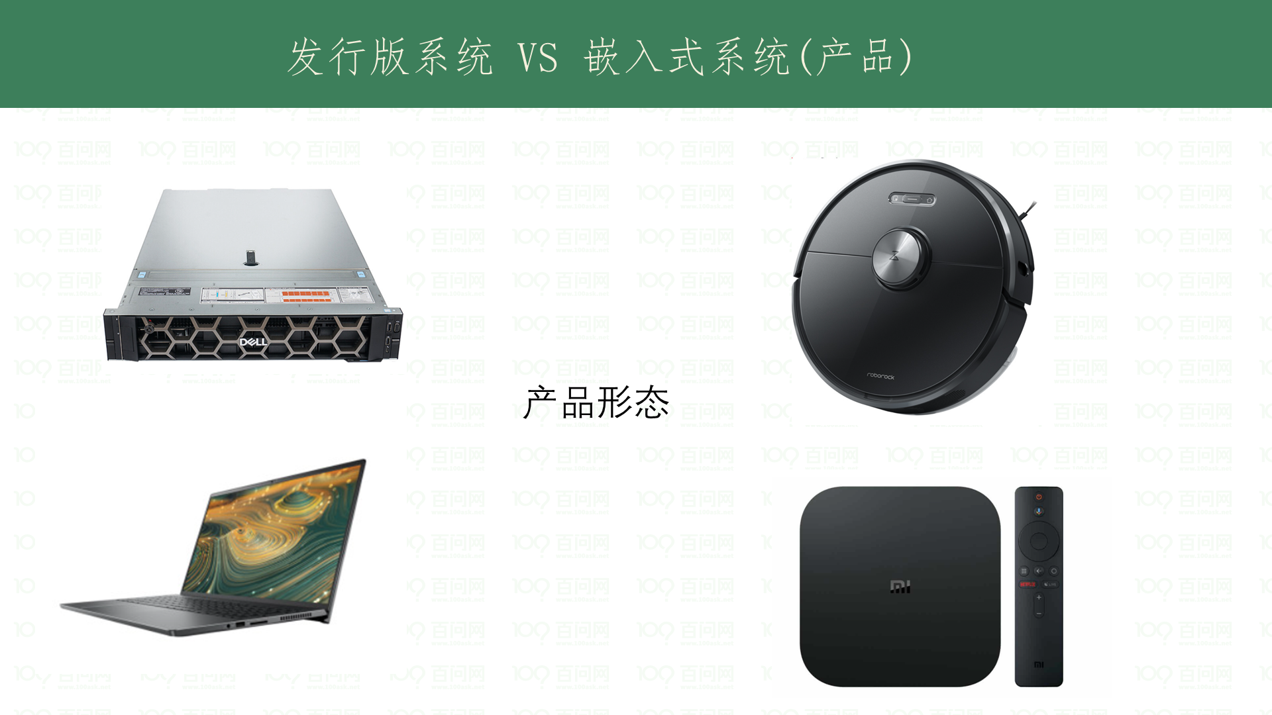

Slide 3
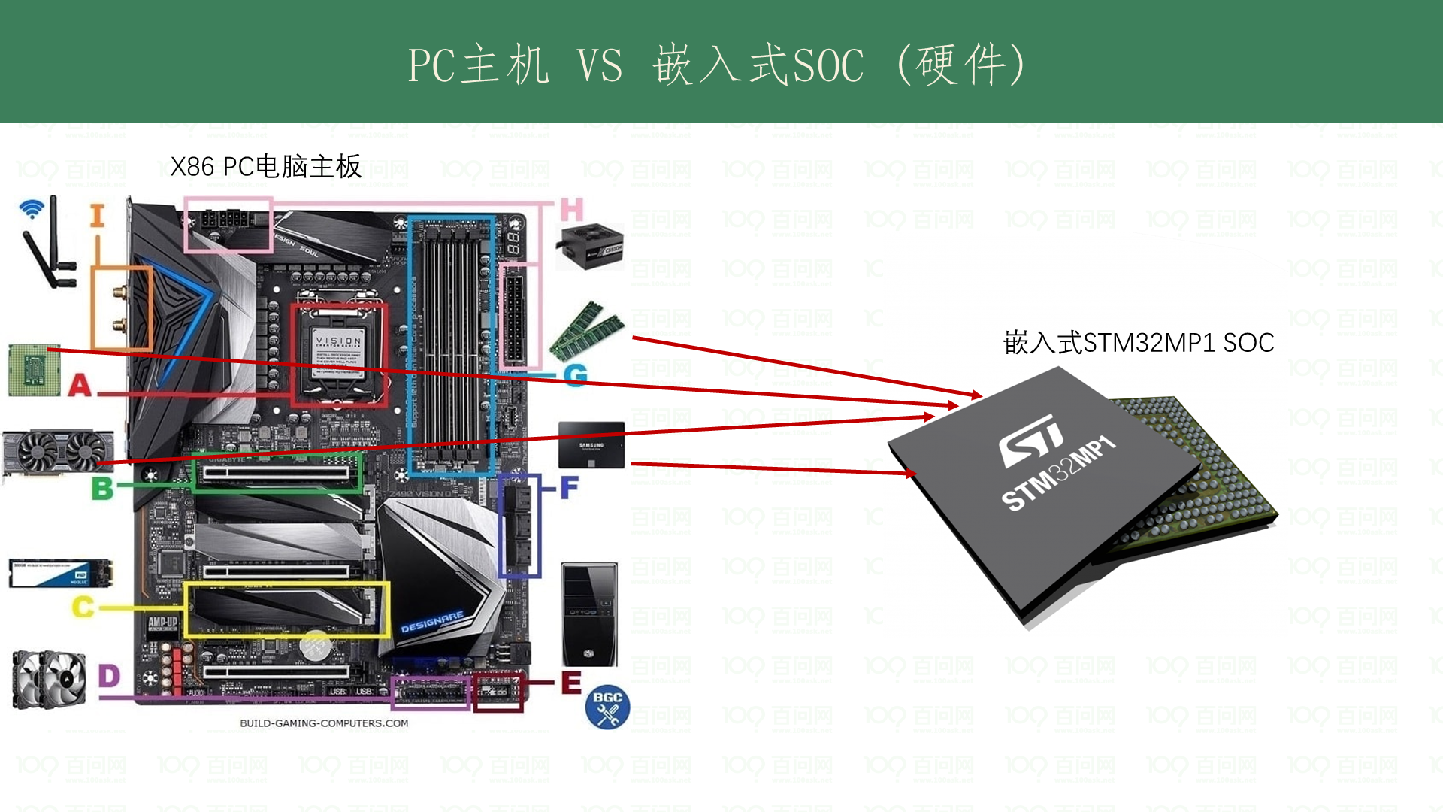
Notes:
参考 https://www.build-gaming-computers.com/motherboard-faq.html

Slide 4
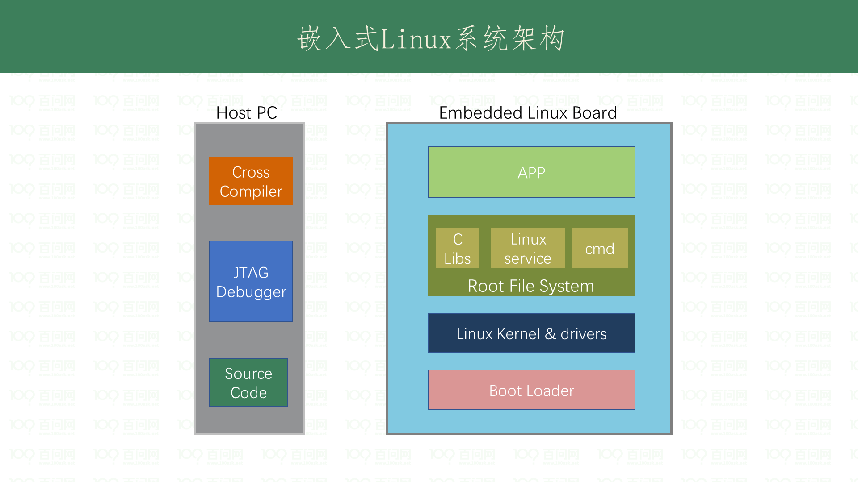

Slide 5
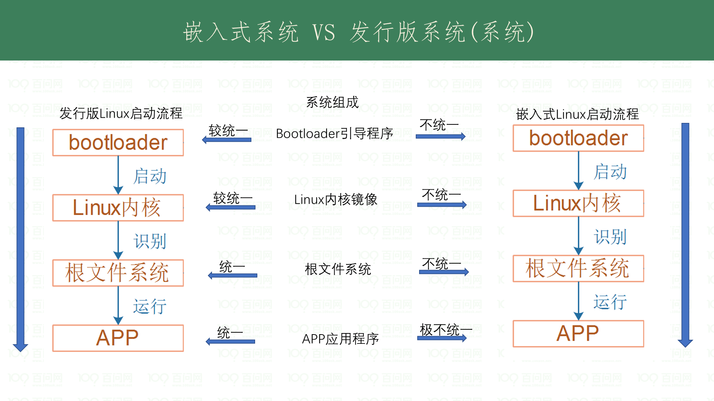

Slide 6
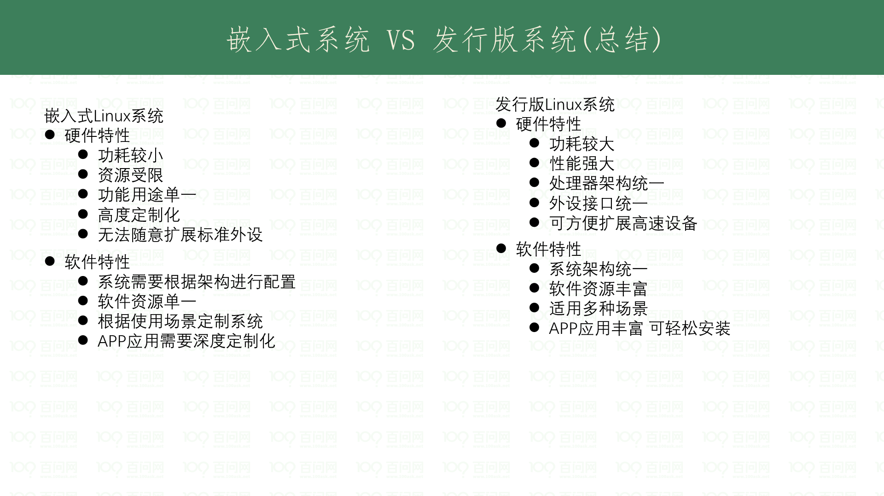

Slide 7
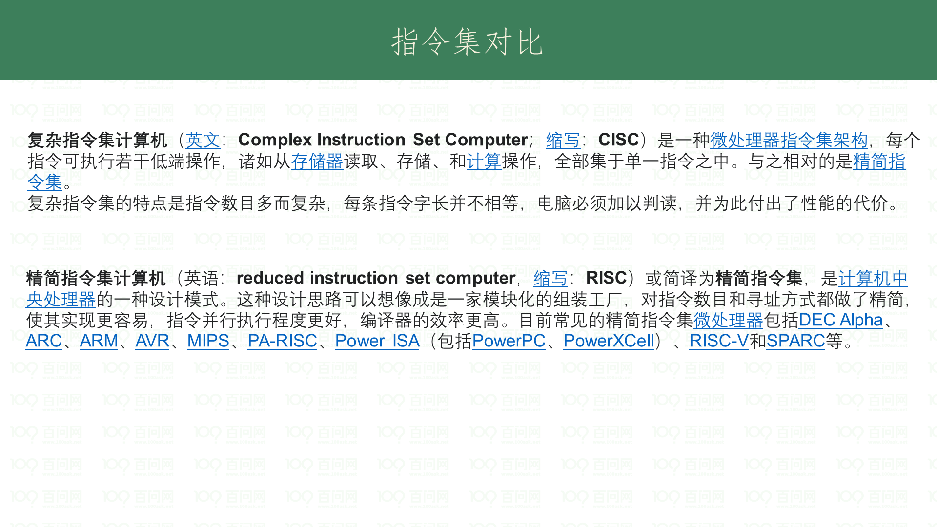
Notes:
指令集对比 https://cs.stanford.edu/people/eroberts/courses/soco/projects/2000-01/risc/risccisc/

Slide 8
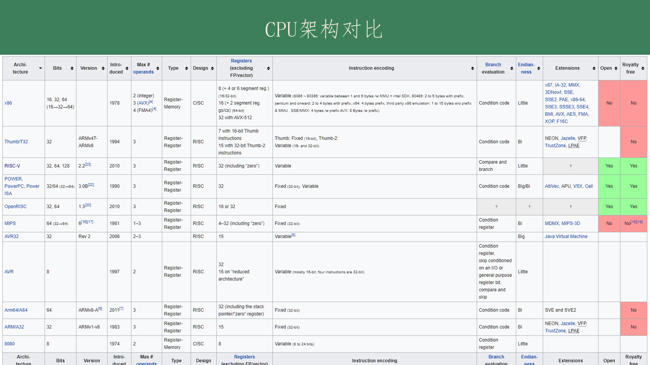
Notes:
参考 https://en.wikipedia.org/wiki/Comparison_of_instruction_set_architectures

Slide 9
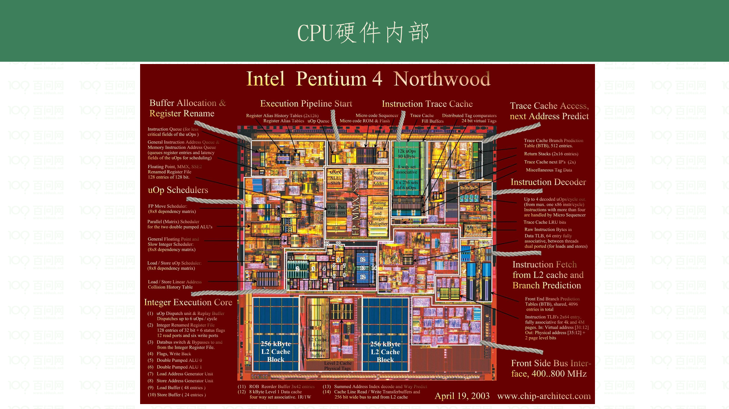

Slide 10
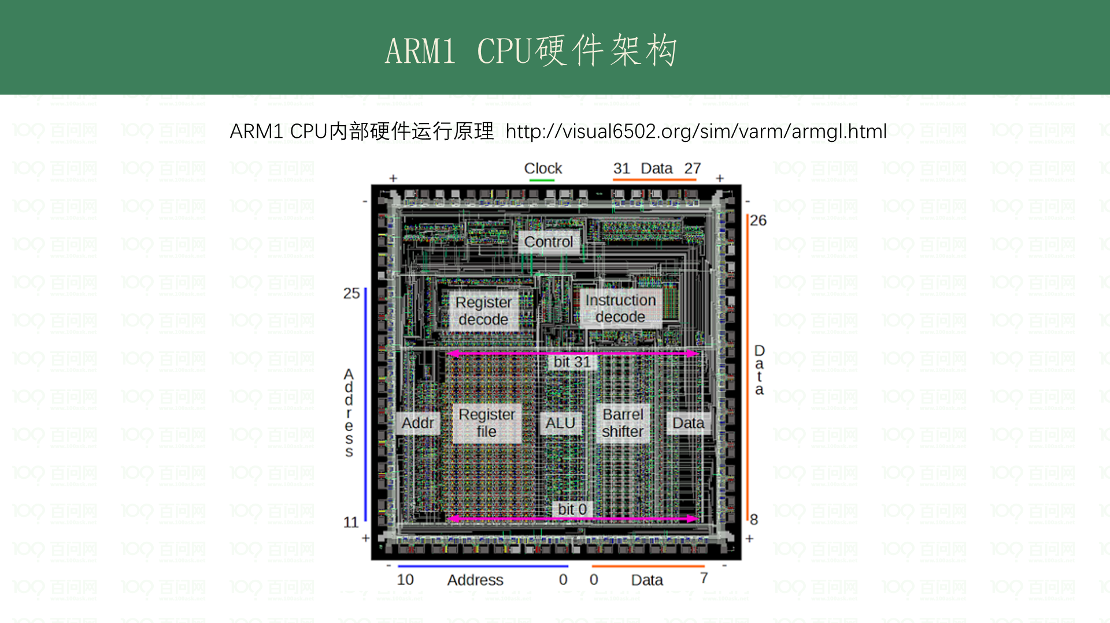

Slide 11
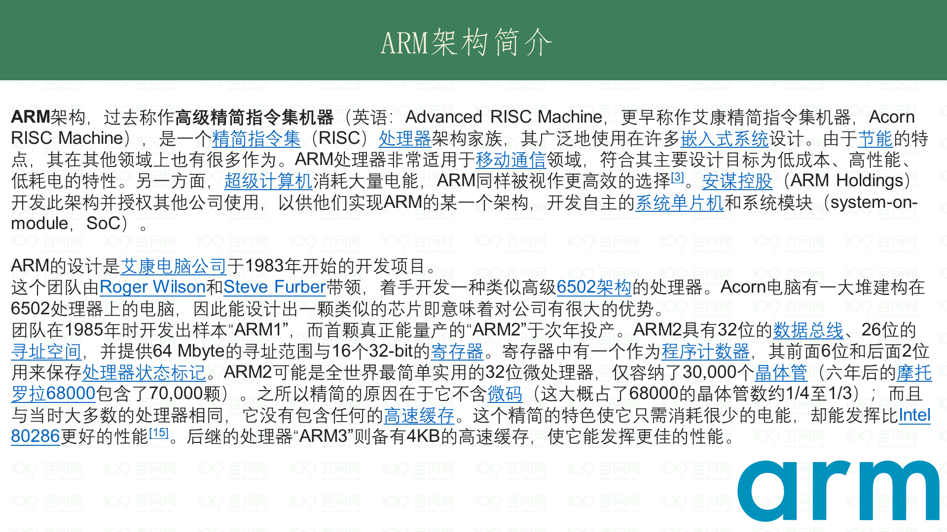
Notes:
https://en.wikipedia.org/wiki/ARM_architecture

Slide 12
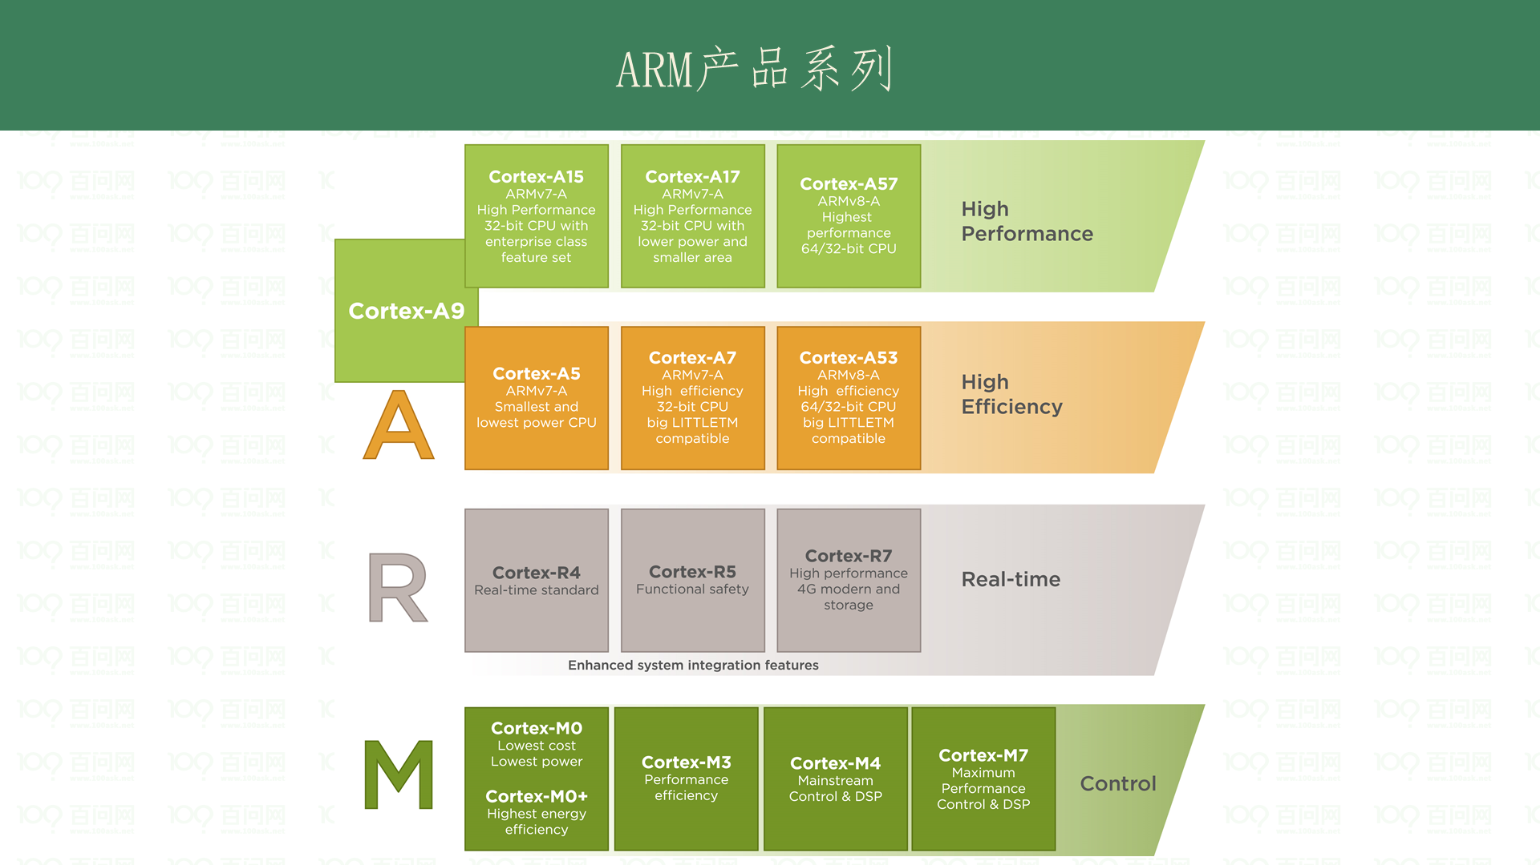

Slide 13
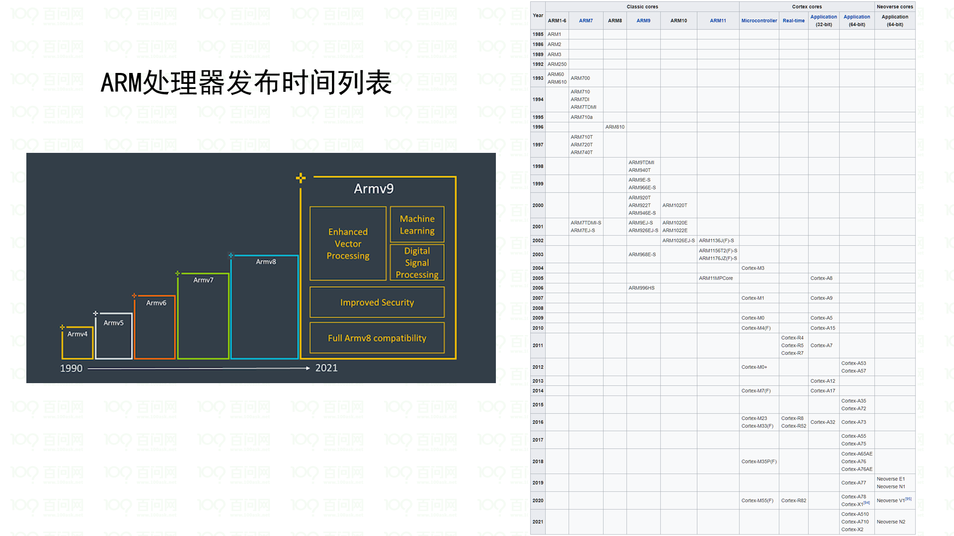
Notes:
https://en.wikipedia.org/wiki/ARM_architecture

Slide 14
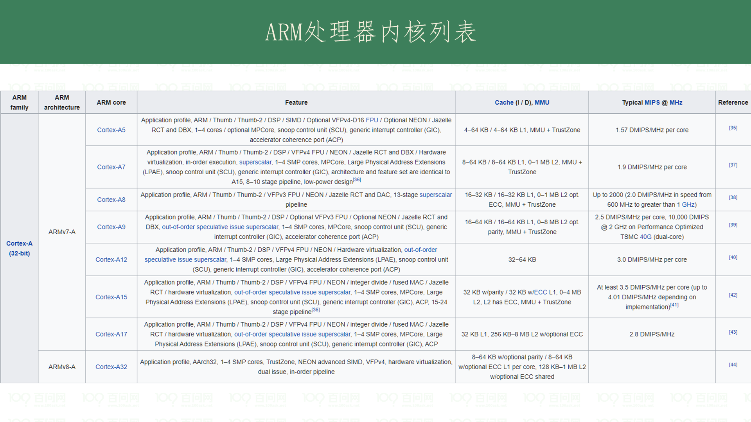
Notes:
参考 https://en.wikipedia.org/wiki/List_of_ARM_microarchitectures

Slide 15
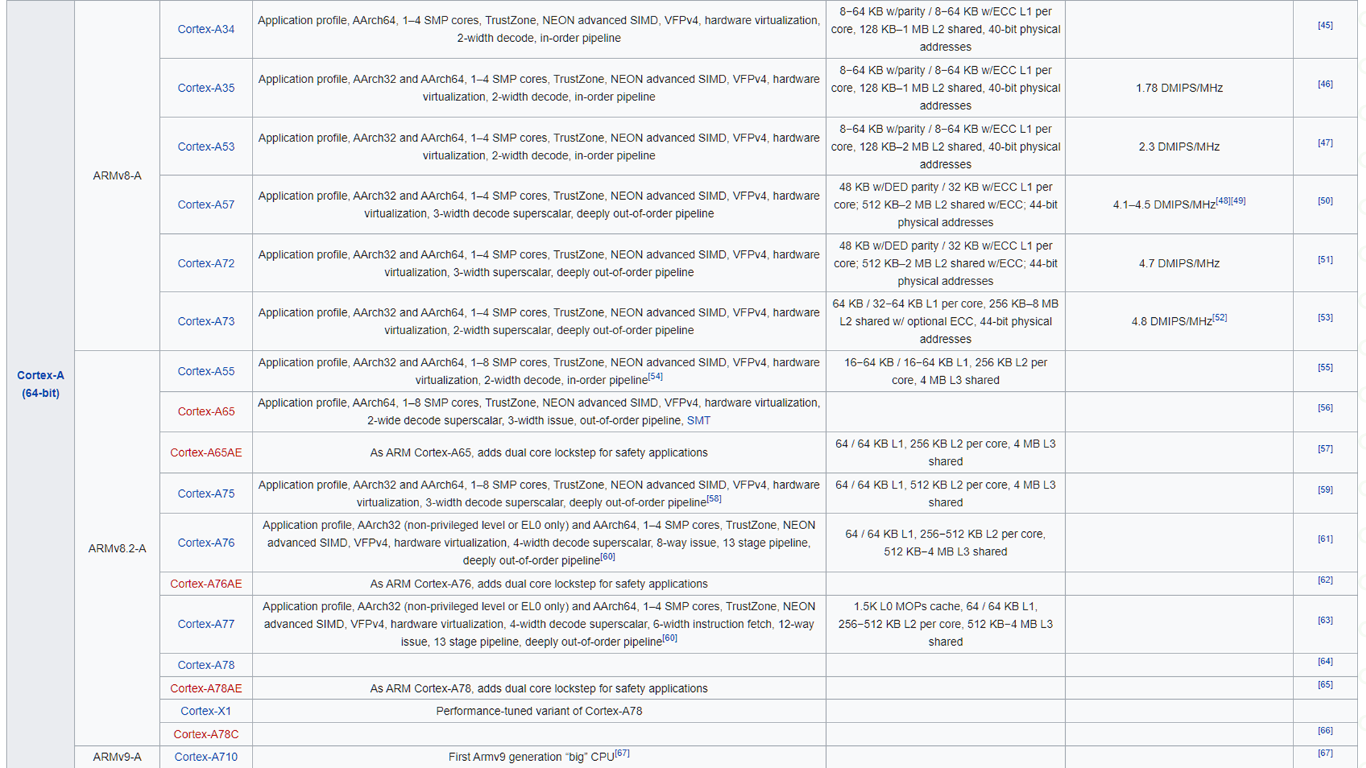
Notes:
参考 https://en.wikipedia.org/wiki/List_of_ARM_microarchitectures

Slide 16
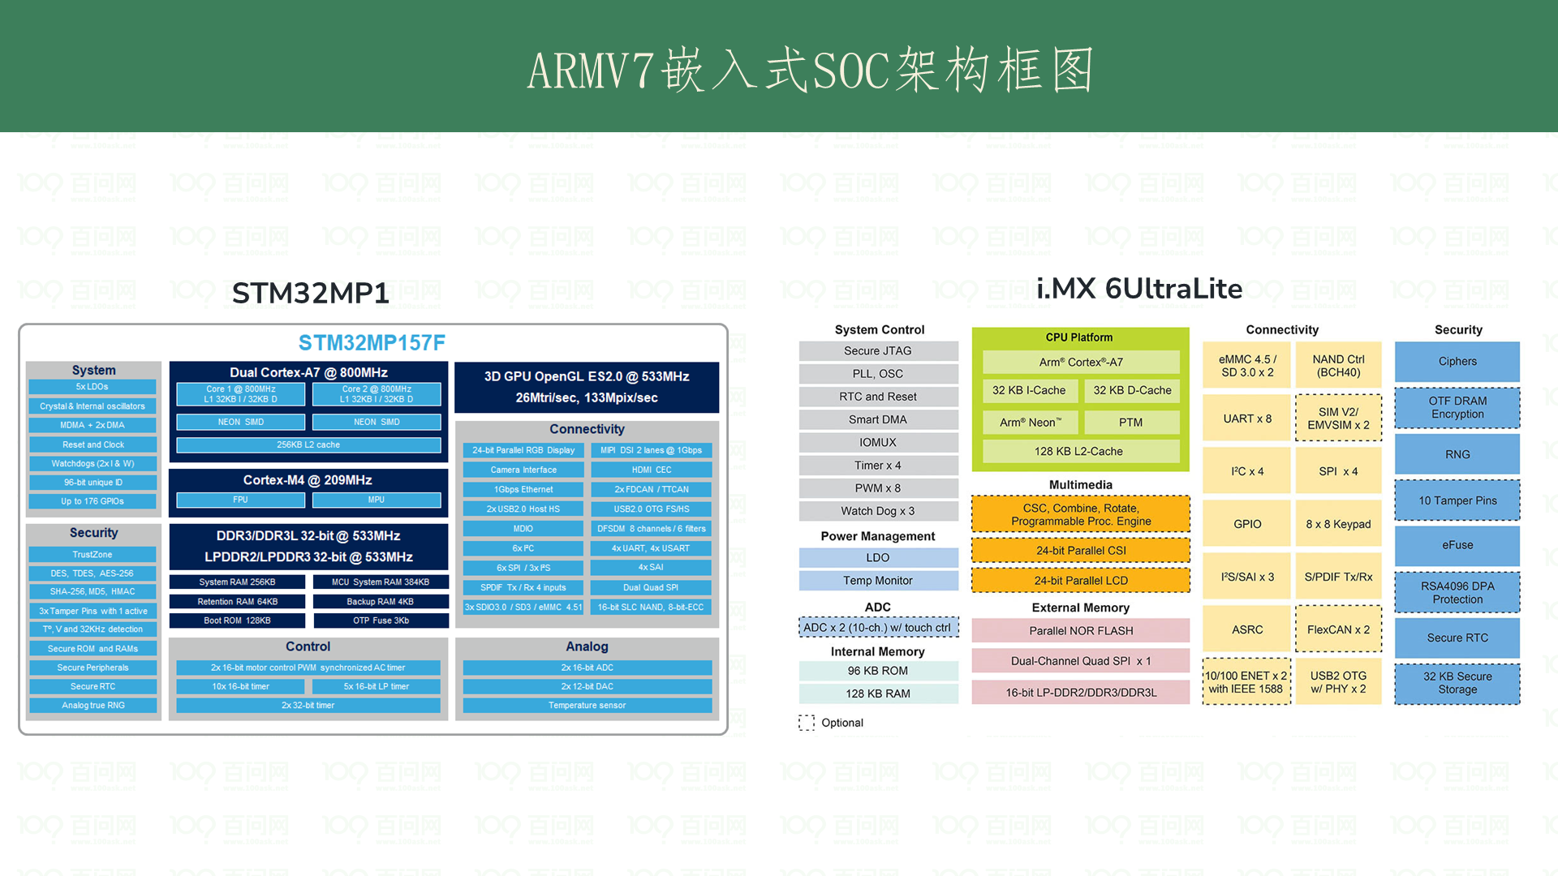
Notes:
获取对应手册 https://developer.arm.com/documentation#sort=relevancy

Slide 17
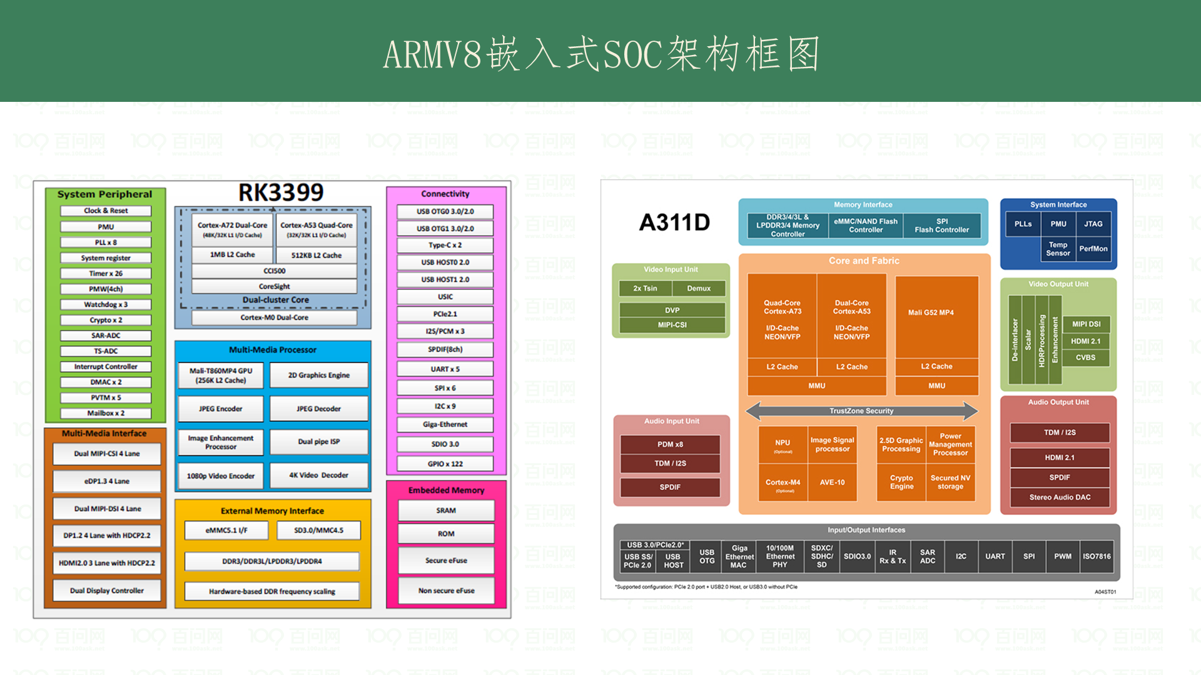
Notes:
获取对应手册 https://developer.arm.com/documentation#sort=relevancy

Slide 18
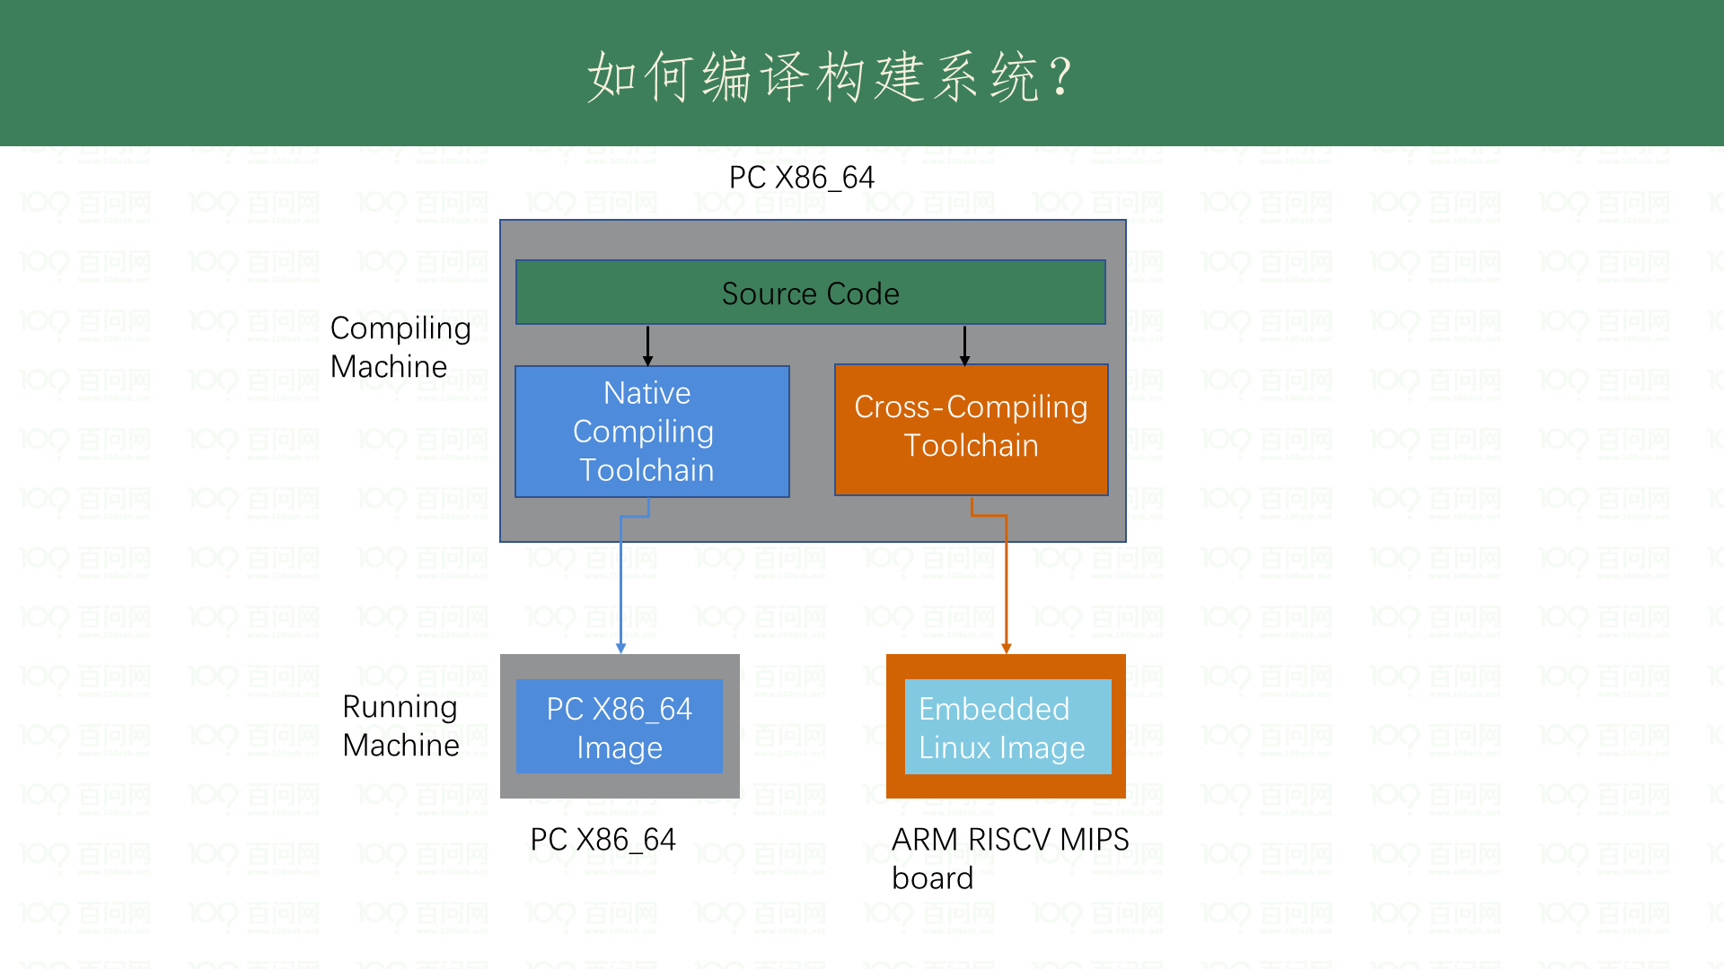

Slide 19
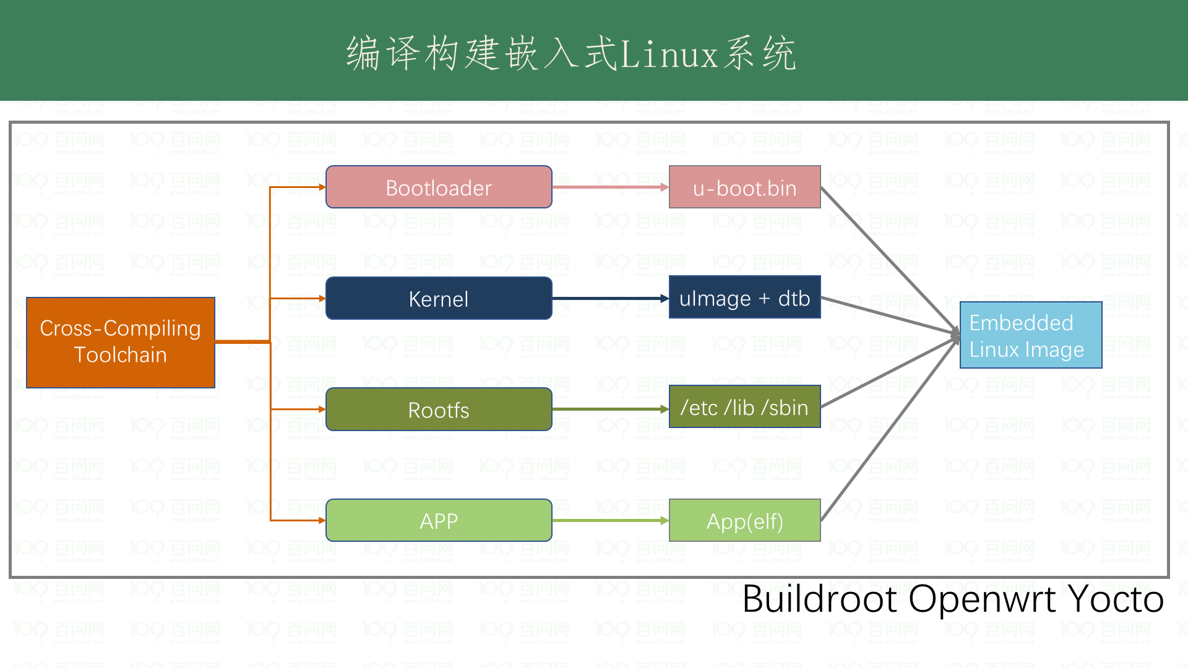

Slide 20
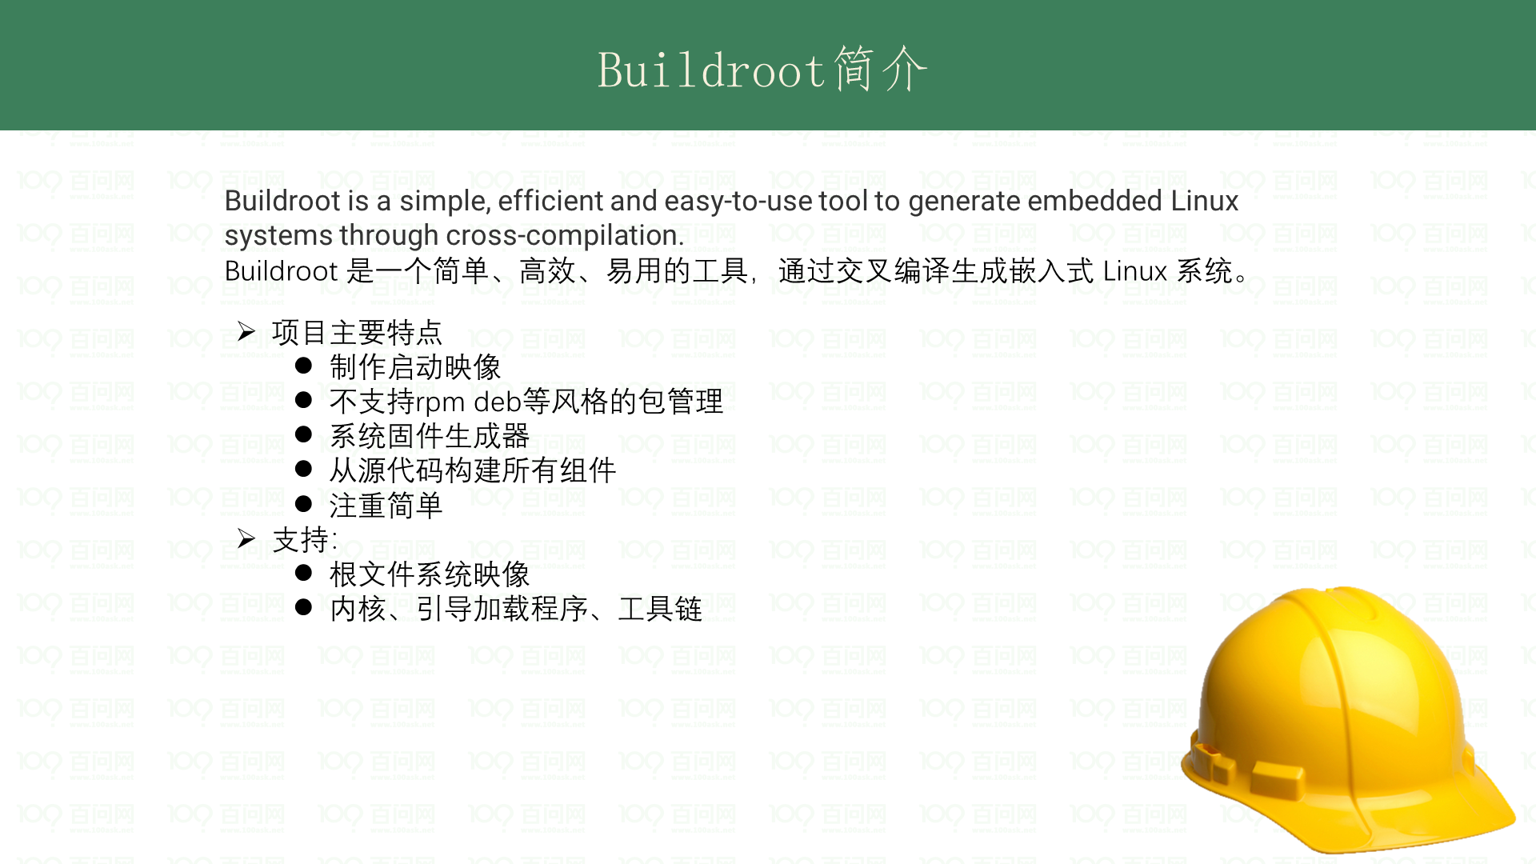
Notes:
官网 ： https://buildroot.org/

Slide 21
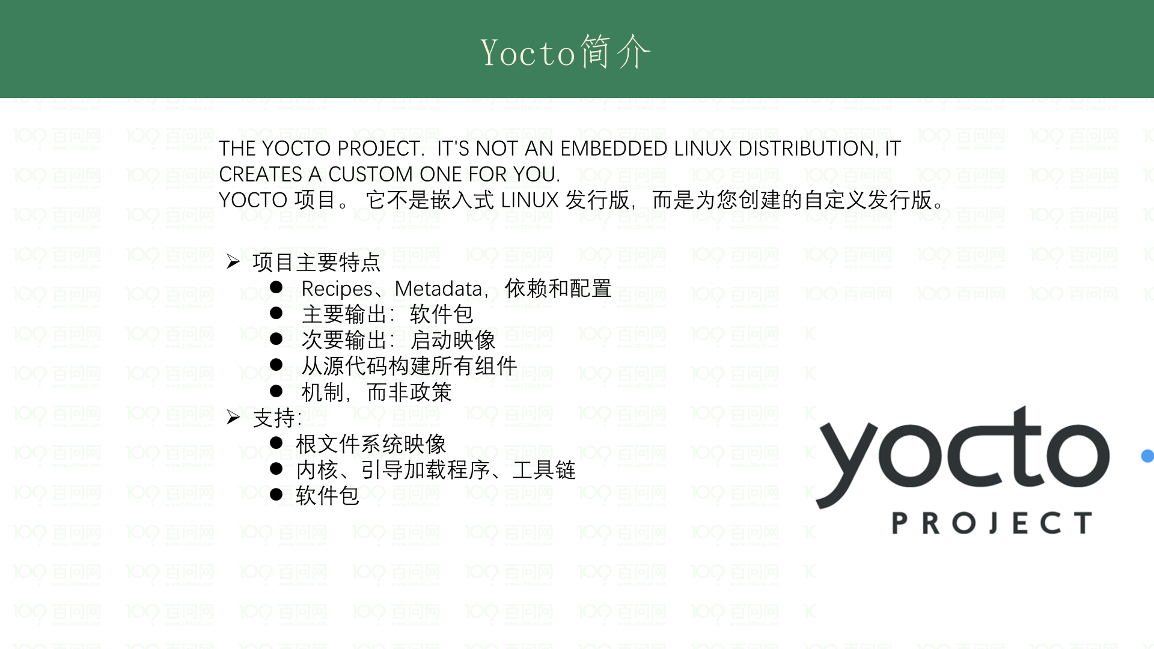
Notes:
官网：https://www.yoctoproject.org/

Slide 22
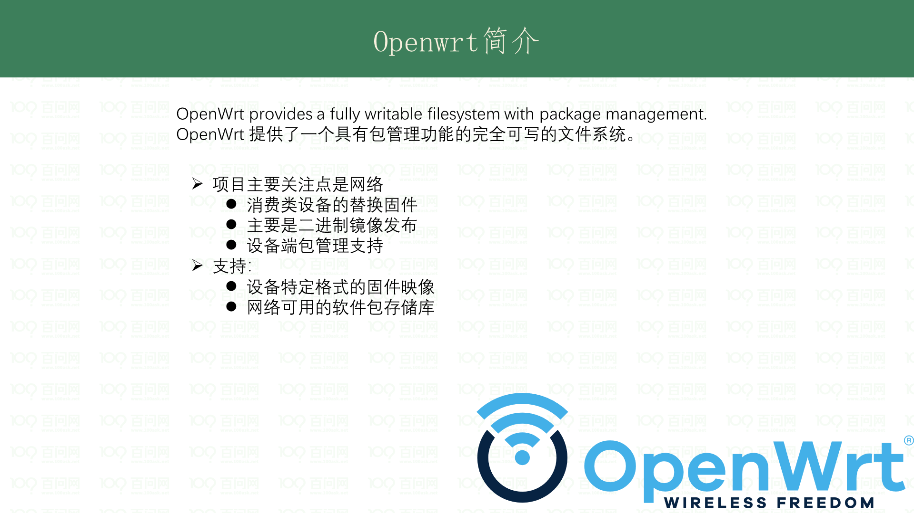
Notes:
官网： https://openwrt.org/

Slide 23
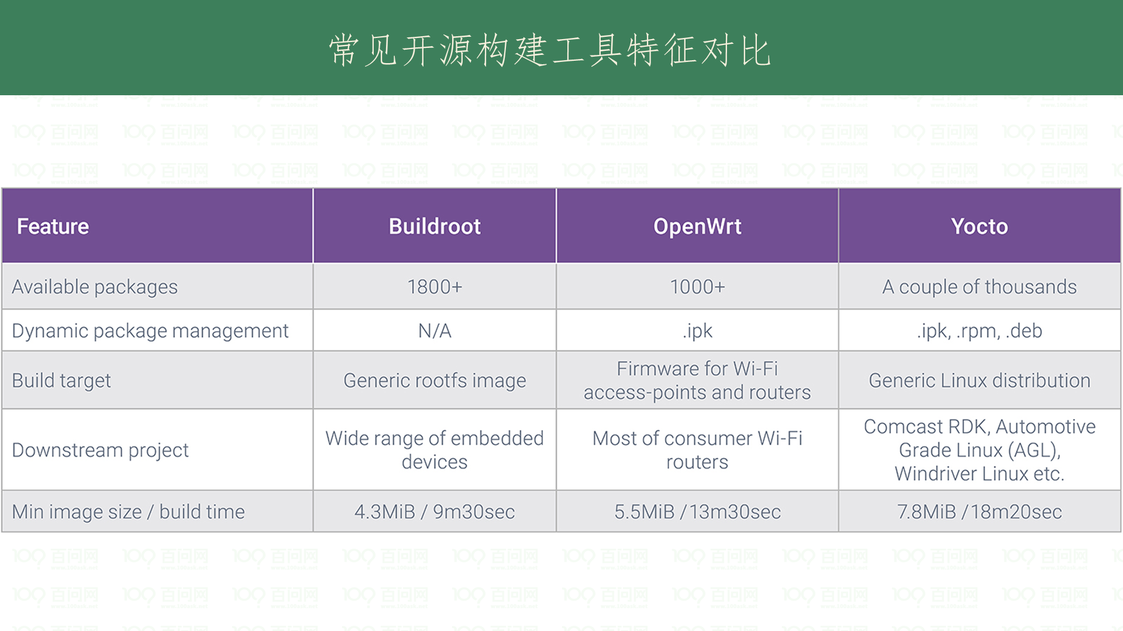

Slide 24
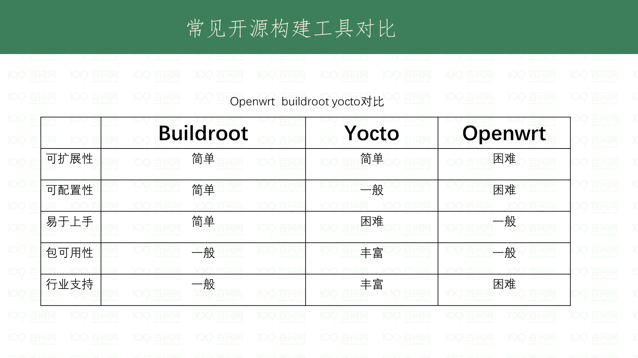

Slide 25
